Slide 1
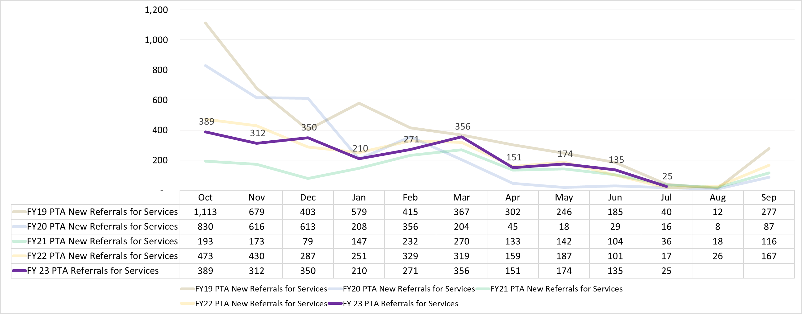
MRS Performance – Prior-to-application (PTA) Referrals for Services
Year-to-date (YTD) Cumulative Totals – PTA Referrals
Fiscal Year | Cases
FY23 (Oct-July): FY23 Year End: | 2,373
FY22 (Oct-July): FY22 Year End: | 2,553 2,746
FY21 (Oct-July): FY21 Year End: | 1,509 1,643
FY20 (Oct-July): FY20 Year End: | 2,962 3,057
FY19 (Oct-July): FY19 Year End: | 4,329 4,289
MICHIGAN REHABILITATION SERVICES

Slide 2
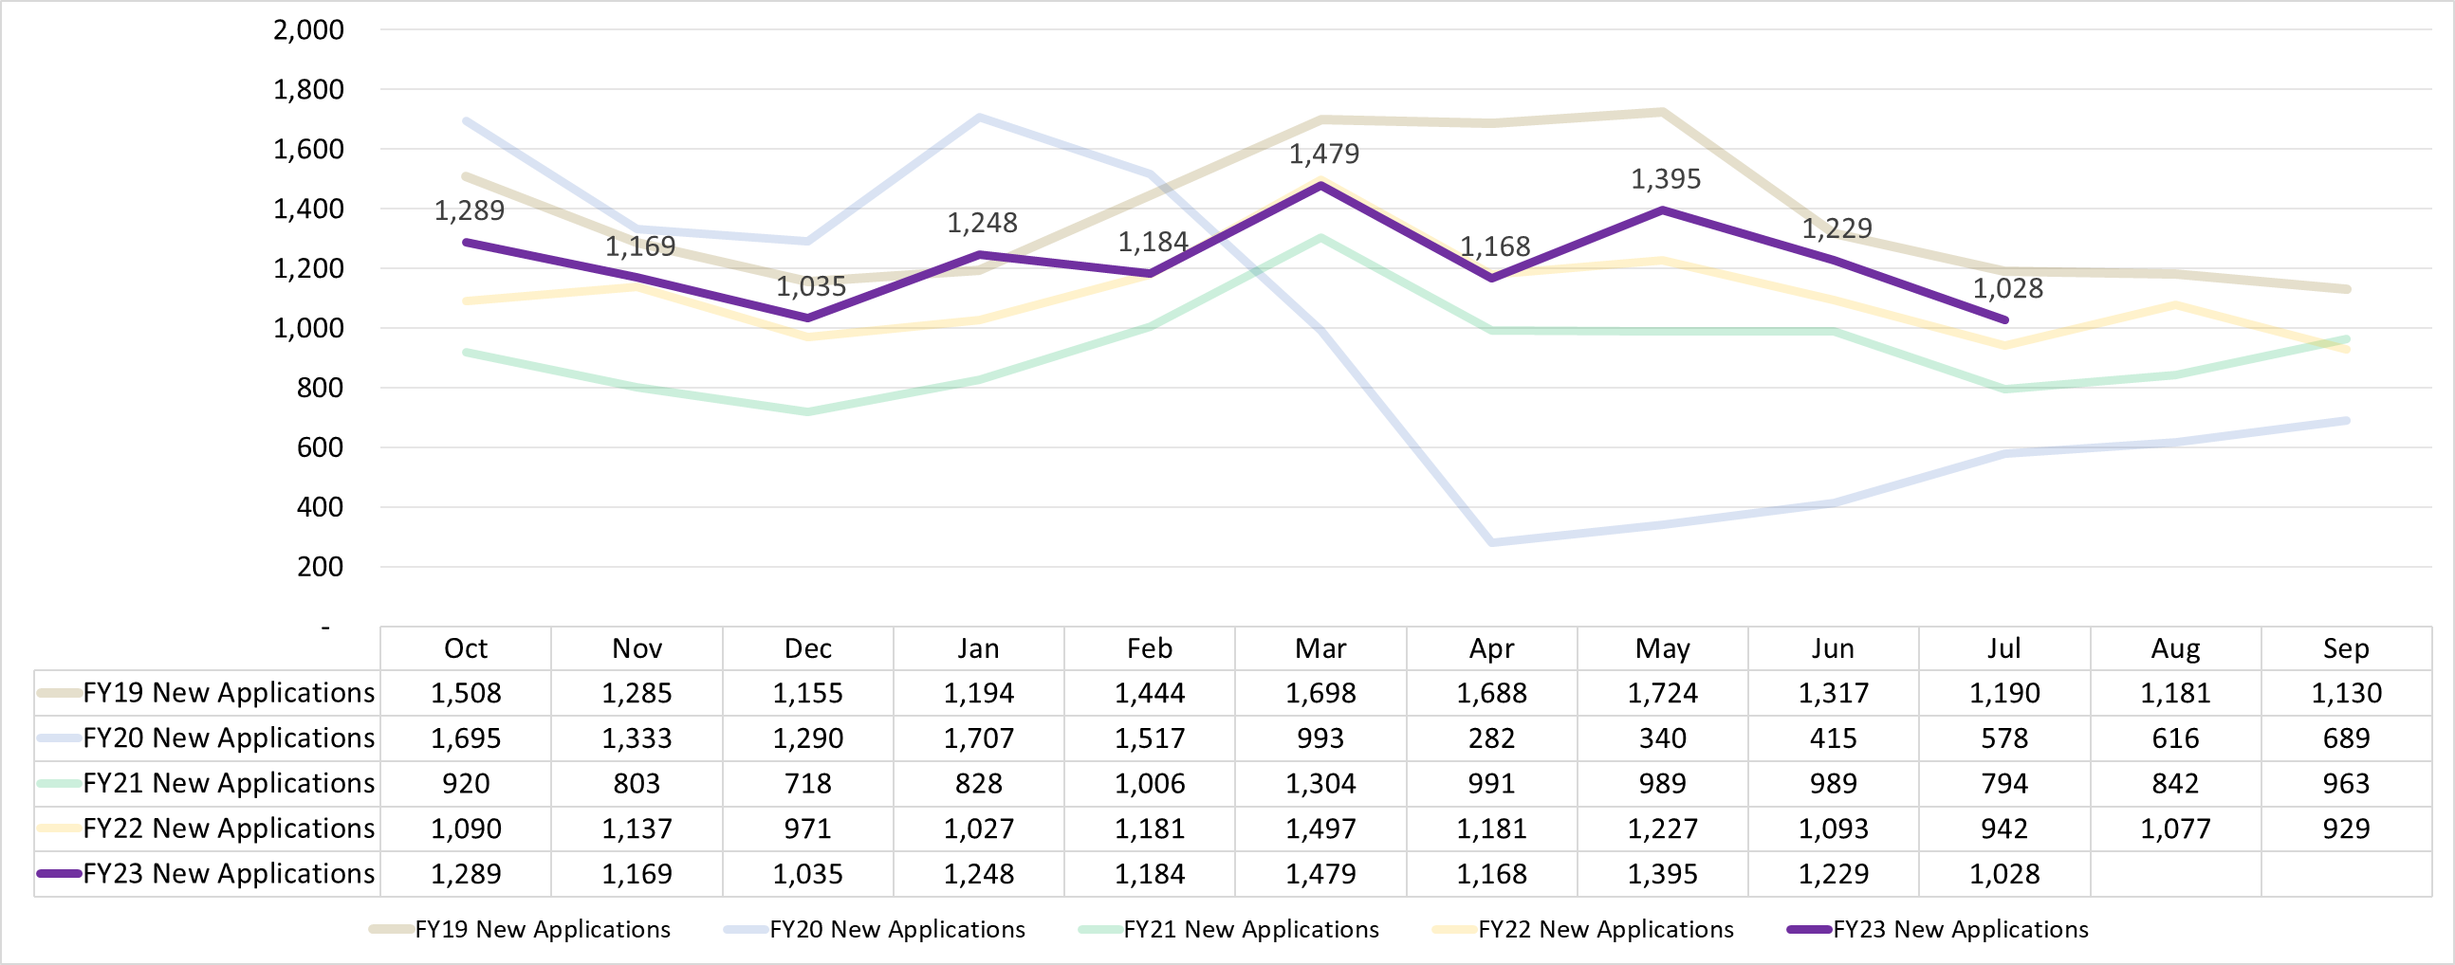
MRS Performance – New VR Applications
Year-to-date (YTD) Cumulative Totals – New Applications
Fiscal Year | Cases
FY23 (Oct-July): FY23 Year End: | 12,224
FY22 (Oct-July): FY22 Year End: | 11,346 13,352
FY21 (Oct-July): FY21 Year End: | 9,354 11,159
FY20 (Oct-July): FY20 Year End: | 10,150 11,455
FY19 (Oct-July): FY19 Year End: | 14,203 16,514
MICHIGAN REHABILITATION SERVICES

Slide 3
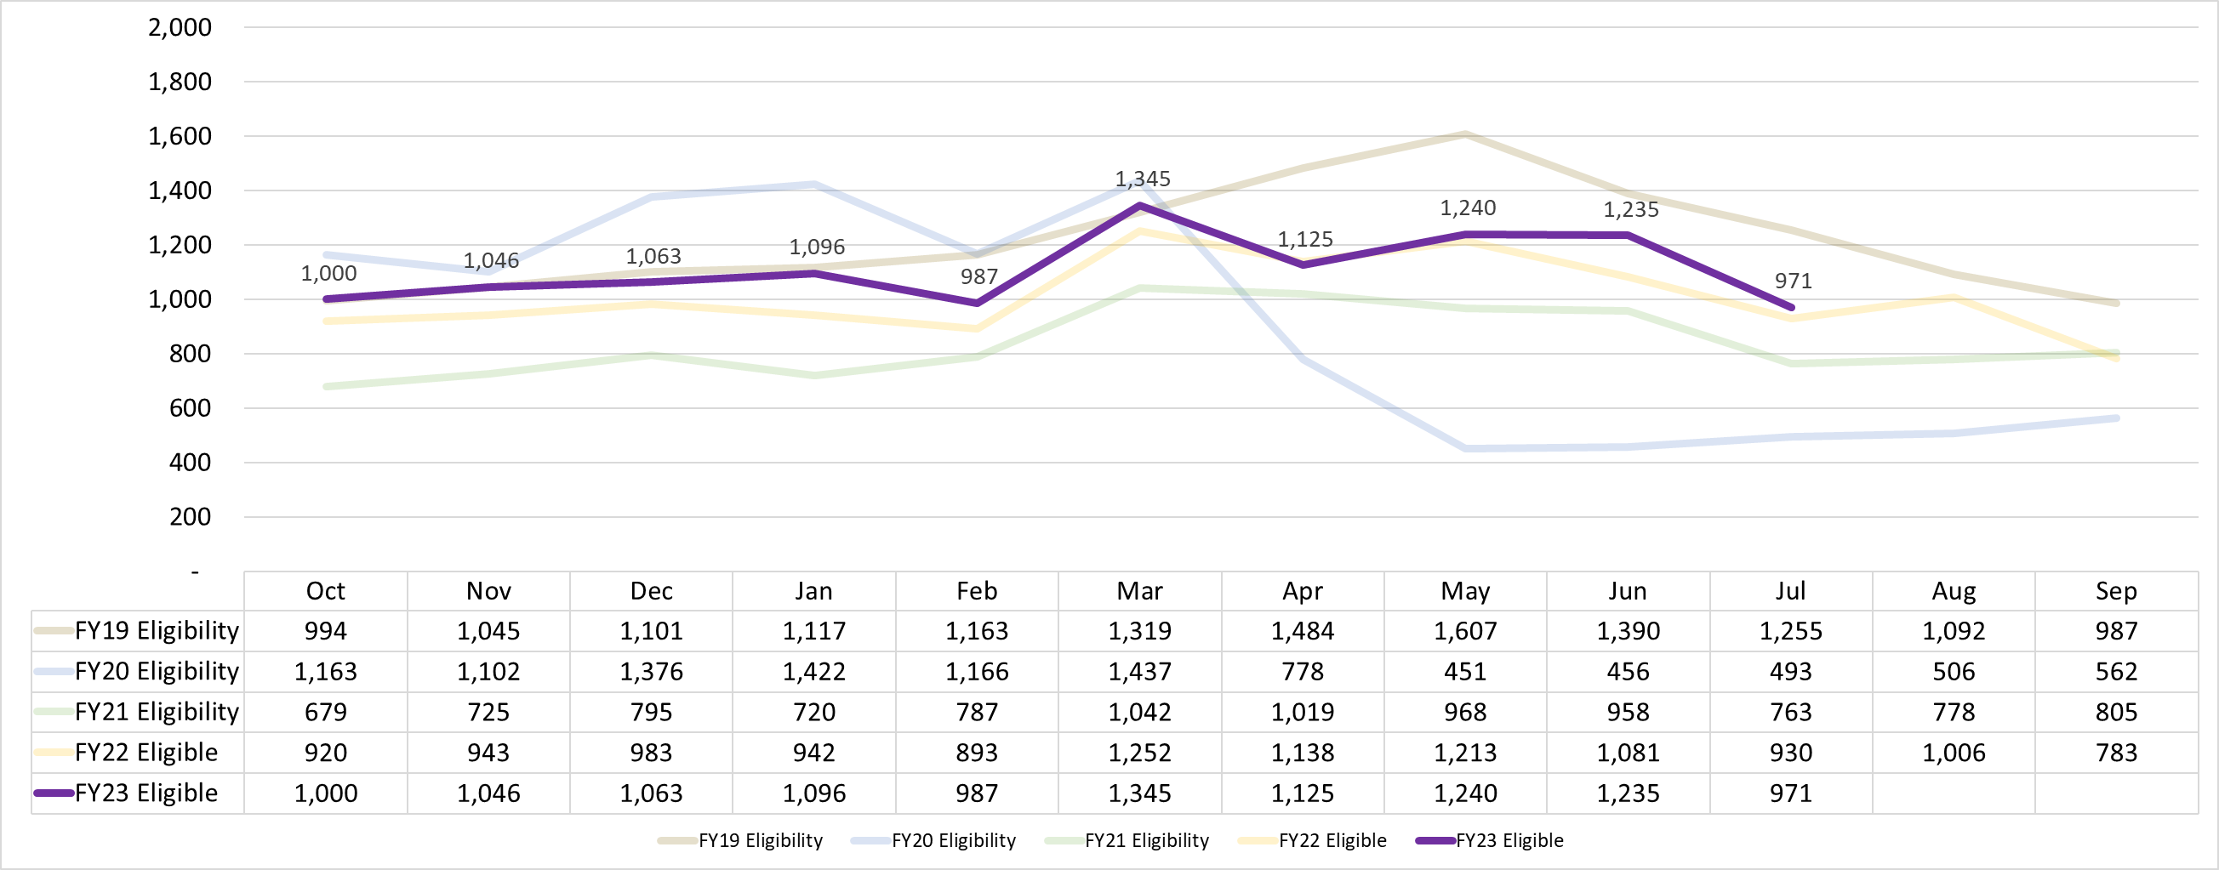
MRS Performance – Eligibility
Year-to-date (YTD) Cumulative Totals - Eligibility
Fiscal Year | Cases
FY23 (Oct-July): FY23 Year End: | 11,108
FY22 (Oct-July): FY22 Year End: | 10,295 12,084
FY21 (Oct-July): FY21 Year End: | 8,456 10,039
FY20 (Oct-July): FY20 Year End: | 9,844 10,912
FY19 (Oct-July): FY19 Year End: | 12,475 14,554
MICHIGAN REHABILITATION SERVICES

Slide 4
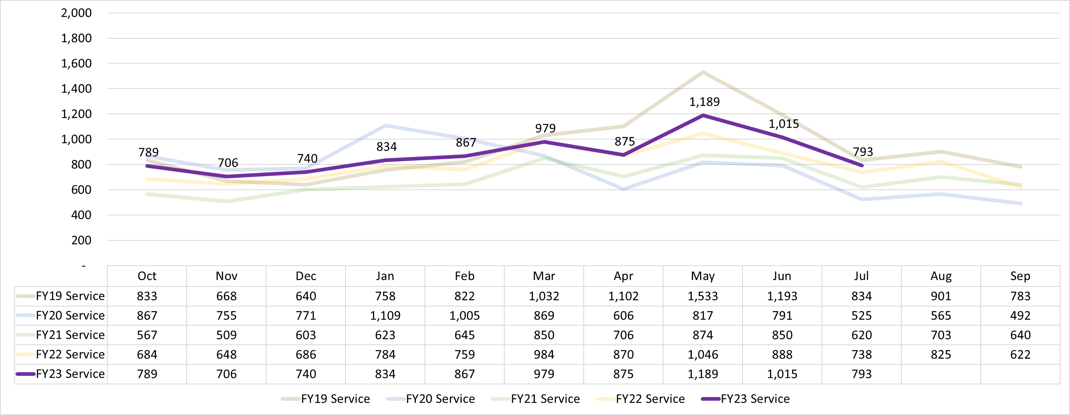
MRS Performance – Service / IPE
Year-to-date (YTD) Cumulative Totals – Service/IPE
Fiscal Year | Cases
FY23 (Oct-July): FY23 Year End: | 8,787
FY22 (Oct-July): FY22 Year End: | 8,087 9,534
FY21 (Oct-JJuly): FY21 Year End: | 6,849 8,192
FY20 (Oct-July): FY20 Year End: | 8,115 9,172
FY19 (Oct-July): FY19 Year End: | 9,415 11,099
MICHIGAN REHABILITATION SERVICES

Slide 5
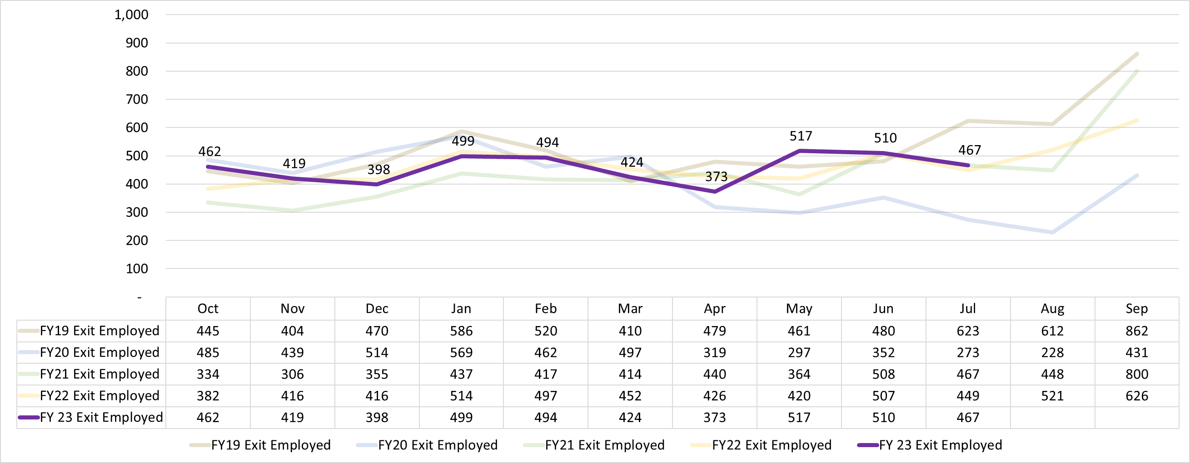
MRS Performance – Exit Employed
Year-to-date (YTD) Cumulative Totals – Exit Employed
Fiscal Year | Cases
FY23 (Oct-July): FY23 Year End: | 4,563
FY22 (Oct-July): FY22 Year End: | 4,479 5,626
FY21 (Oct-July): FY21 Year End: | 4,042 5,290
FY20 (Oct-July): FY20 Year End: | 4,207 4,866
FY19 (Oct-July): FY19 Year End: | 4,878 6,352
MICHIGAN REHABILITATION SERVICES

